Slide 1
Face Recognition using Linear Discriminant Analysis
Veeresha M Thotigar
Student ID : 1620975
Email ID : vmt9mm@mail.umkc.edu

Slide 2
Face Recognition
Face recognition systems generally divided into two categories:
Identification - set-up the similarity between a given face image and all the face images in a large database is computed, the top match is returned as the recognized identity of the subject.
Verification - set-up the match between a given face image and the face image is computed, the returned result as the authentication of the subject.

Slide 3
ATT - Dataset
The AT&T database is freely downloadable and contains a set of 400 face images (http://www.cl.cam.ac.uk/research/dtg/attarchive/facedatabase.html)
There are ten different images of each of 40 distinct subjects
For some subjects, the images were taken at different times, varying the lighting, facial expressions (open / closed eyes, smiling / not smiling) and facial details (glasses / no glasses)

Slide 4
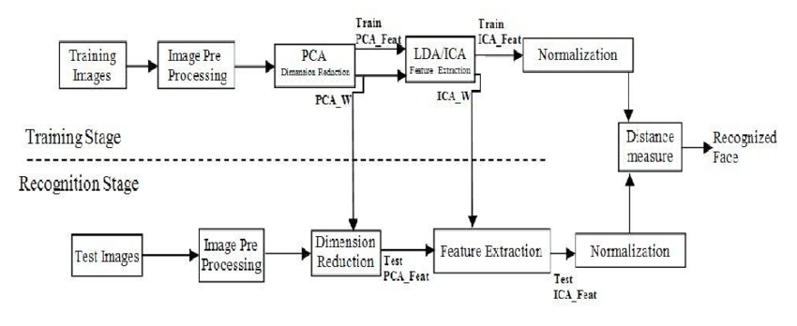
Architecture diagram

Slide 5
Linear Discriminant Analysis
The Linear Discriminant Analysis (LDA) approach outperforms the Principal Component Analysis (PCA) approach in face recognition tasks.
Due to the high dimensionality of a image space, many LDA based approaches, however, first use the PCA to project an image into a lower dimensional space or so-called face space, and then perform the LDA to maximize the discriminatory power

Slide 6
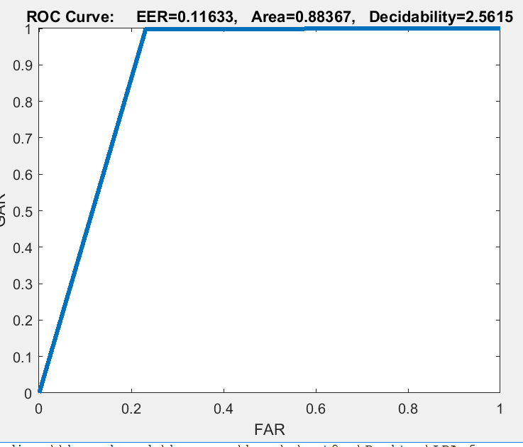
Results
Mean values,
FAR - 0.01
FRR - 0.23
GAR - 0.76
GRR - 0.98
Fig : ROC curve

Slide 7
Comparison between PCA vs LDA
Both Principle Component Analysis (PCA) and Linear Discriminant Analysis (LDA) are well known algorithms for face recognition problem, PCA is well known for dimensionality reduction but LDA maximizes the discriminatory power of the classes in the dataset. But LDA alone faces the difficulty to process the high dimensionality image dataset. Hence first projecting the image dataset to lower dimension using PCA and then applying LDA to maximize the interclass projection simplifies and maximize the processing ability.
We have used 5 images of 40 persons as training set and trained both PCA and PCA+LDA , compared the test results by using rest 5 images of 40 persons by calculating the genuine and im-posture scores. Area for PCA is 0.39 and for LDA is 0.88, it is clear that LDA outperforms well than PCA alone.

Slide 8
Thank you

